Slide 1
Addressing Clean Water and Sanitation: A Data-Driven Approach
Bongakonke Mtshali
28/08/2024

Slide 2
Introduction
SDG 6: Clean Water and Sanitation
Monitoring and Managing Water Quality: Urban areas often struggle with ensuring that their water supply meets safety standards. Contaminated water can lead to health issues. The problem to address is monitoring water quality in urban areas to ensure that water is safe for consumption and meets regulatory standards.

Slide 3
Overview
The Entity-Relationship Diagram (ERD) provided outlines the structure of a database designed for monitoring and managing water quality. This diagram visually represents the key entities involved in the system and the relationships between them. The goal is to ensure comprehensive data management for effective water quality monitoring.

Slide 4
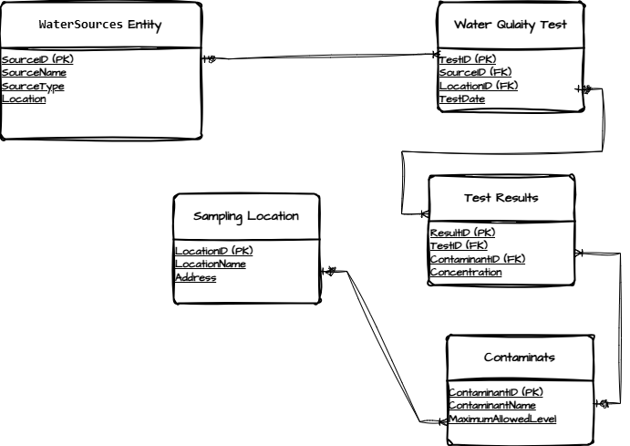
Entity Relationship

